Slide 1
JNCIS-ENT
Tunnels

Slide 2
Tunnel Applications and Considerations
1
Tunneling usage and privacy

Slide 3
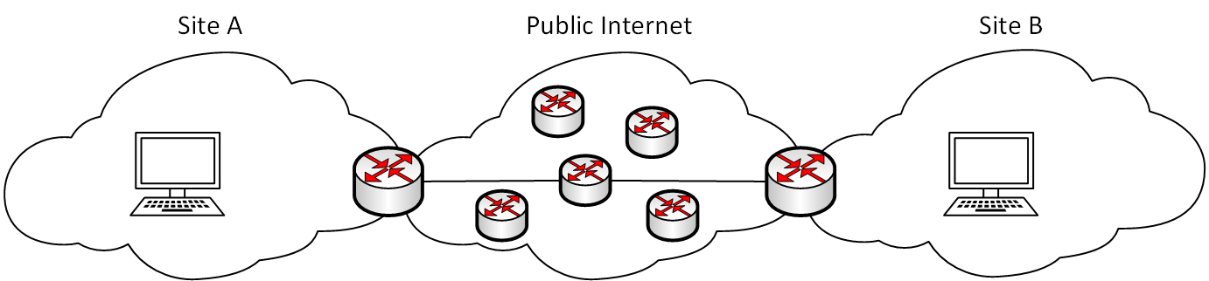
What is an IP Tunnel?
An IP tunnel creates an established channel such that 2 networks may communicate.
Typically, the channel bridges networks across a public or other network where the destinations would not be directly routable.
This can allow networks with private addressing to communicate across the public internet without the use of NAT
A tunnel may or may not encrypt the payload data
IPsec is a suite of protocols for creating secure (encrypted) tunnels either between endpoint hosts or between network gateways

Slide 4
IP Tunneling Encapsulation
IP tunneling requires the encapsulation of an entire IP packet, including IP header, upper protocol headers and payload data, inside of another IP header.
IP header
TCP/UDP/Upper protocol header
Payload
Inner IP header
TCP/UDP/Upper protocol header
Payload
Outer IP header
Tunnel header
IP header
TCP/UDP/Upper protocol header
Payload

Slide 5
IP Tunneling Applications
IP Tunneling can allow packets to traverse networks that would otherwise not be able to route the protocol
Non-IP packets, IPv6 and non-routable IPv4 packets are some examples of use cases for IP tunneling
Non-IP traffic is typically tunneled using Generic Route Encapsulation (GRE)
Tunnel
MPLS
RFC1918 IPv4
IPv6
MPLS
RFC1918 IPv4
IPv6

Slide 6
IP Tunneling Considerations
IP-IP and GRE tunnels are stateless by default and provide no keep-alive mechanisms
BFD and some implementations of tunneling protocols provide keepalive functionality
IP packet fragmentation can cause problems with some tunneled protocols
Not all encapsulated protocols will function correctly if fragmentation occurs across the the path of the IP tunnel
A tunnel termination endpoint cannot be routed through the tunnel itself
If a route is learned via a tunnel which will cause the outer IP header to be routed through the tunnel, the tunnel will flap continuously
Tunnel
MPLS
RFC1918 IPv4
IPv6
MPLS
RFC1918 IPv4
IPv6

Slide 7
IP Tunneling Requirements
Since the tunnel is essentially just some packets that are encapsulated in an IP header, IP connectivity between the endpoints is required
The source and destination must be fully routable
A tunnel interface is used on Junos devices to tunnel traffic
GRE tunnels use gr-x/x/x interfaces
IP-IP tunnels use ip-x/x/x interfaces
Tunnel
MPLS
RFC1918 IPv4
IPv6
MPLS
RFC1918 IPv4
IPv6

